Slide 1
SIR SYED UNIVERSITY OF ENGINEERING & TECHNOLOGY
Final Year Project Presentation
Department of Software Engineering
Batch 2022F · Session 2025–2026
Project No. 51
Notes:
Good morning. We are group 51 from the Department of Software Engineering, presenting our final year project, BuilderConnect.

Slide 2

51
PROJECT NO.
BuilderConnect
An online marketplace for builders & contractors — bringing trust and transparency to Pakistan's construction industry.
SUPERVISED BY
Miss Kiran Hidayat
Notes:
Our project number is 51. The project is BuilderConnect — an online marketplace connecting clients with verified builders and contractors across Pakistan.

Slide 3
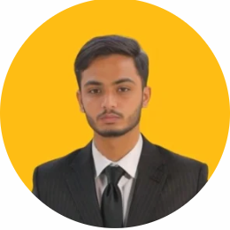
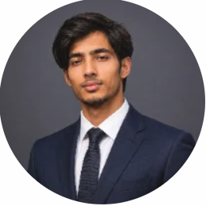
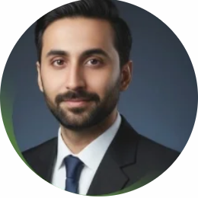
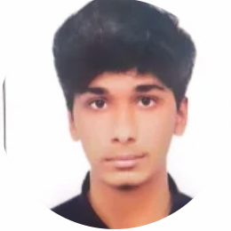
THE TEAM
Team Members & Work Distribution
Ali Hasan Sheikh
Hammad Hussain
M. Jahanzaib Khan
Syed Ahmed Ali
2022F-BSE-178
2022F-BSE-088
2022F-BSE-277
2022F-BSE-054
GROUP LEADER
Frontend & UI/UX Developer
Database Design & Testing
Documentation & Quality Assurance
Full-Stack Developer & Project Architect
Built the React + TypeScript single-page app, the role-based dashboards, responsive layouts and the shared component library.
Designed the relational data model and database connectivity, implemented authentication and contributed to the AI assessment module, and led unit & integration testing of the backend services.
Authored the project documentation (SRS, SDD, SDG), performed requirement analysis & QA, and coordinated user-acceptance testing.
Defined the architecture and planned the sprints. Built the Spring Boot backend — auth & security, REST APIs, the bidding & milestone lifecycle and the Flyway schema — and led AI-suite and Stripe integration.
Notes:
Our team of four. Ali Hasan Sheikh is group leader and full-stack developer who architected the system; Hammad built the React front-end; Jahanzaib owned the data model and testing; Ahmed led documentation and quality assurance.

Slide 4
01 · THE GAP
Problem Statement
Finding and hiring a reliable builder in Pakistan is informal, opaque, and risky.
Word-of-mouth hiring — clients rely on references and social-media ads with no reliable way to compare options.
No verification or trust — builder credentials, past work, and reputation are impossible to confirm.
Opaque pricing & bidding — quotes are inconsistent and negotiated off the record.
Poor communication & tracking — no shared record of progress, payments, or disputes.
No local platform — global tools like Houzz or HomeAdvisor aren't built for Pakistan's market.
Notes:
In Pakistan, hiring a builder is still driven by word of mouth. There is no verification, no transparent pricing, and no way to track a project — clients carry all the risk.

Slide 5
02 · THE IDEA
Idea / Solution
A trusted digital marketplace that manages the whole journey — from posting a project to the final review.
Verified profiles with portfolios, ratings & reviews.
Structured bidding — clients post, builders bid, clients award.
End-to-end lifecycle — contracts, milestones, payments & sign-off.
Real-time chat plus a supervisor & inspector layer for oversight.
AI suite — assistant, FAQ chatbot, floor-plan & budget tools.
Built for Pakistan — PKR, local areas & Roman-Urdu support.
Notes:
BuilderConnect is a single trusted marketplace: verified builders, structured bidding, and the full project lifecycle managed in one place — with AI assistance built in.

Slide 6
03 · BOUNDARIES & GOALS
Scope and Purpose
Scope
Purpose
Web platform for 8 roles — client, builder, supplier, supervisor, inspector, support, admin, super-admin.
Transparency — open bids, ratings and a shared project record.
Project posting, bidding, award & contract management.
Trust — verified identities, reviews and dispute handling.
Milestones, site logs, inspections & a material marketplace.
Efficiency — one place to hire, communicate and track work.
AI assistant, chatbot, floor-plan & budget estimator.
Accessibility — mobile-friendly, localized for developing regions.
Notes:
The scope is a full web platform serving eight roles across the construction lifecycle. The purpose is to make hiring transparent, trustworthy and efficient.

Slide 7
ARCHITECTURE
System Diagram
PRESENTATION TIER
APPLICATION TIER
DATA TIER
React SPA
Spring Boot API
MySQL
Flyway migrations (V1–V47) · 42 entities · relational schema
React 18 · TypeScript · Vite
Java 17 · Spring Boot 3.2
Tailwind CSS · React Query
Spring Security + JWT auth
8 role-based dashboards
25 controllers · 29 services
REST · JWT WebSocket
STOMP WebSocket (chat)
JPA Hibernate
⇄
⇄
EXTERNAL SERVICES
File storage · Stripe payments · LLM (Claude / Gemini) · Google Places
Browser · Desktop & mobile
REST APIs · MVC architecture
Notes:
Architecture is a classic three tier: a React single-page app talks over REST and WebSocket to a Spring Boot backend, which persists to MySQL through Flyway-managed schema. External services handle files, payments, and AI.

Slide 8
CORE WORKFLOW
Flow Chart
01
→
02
→
03
→
04
Register & get verified
Client posts project
Builders submit bids
Client awards bid
↓
05
→
06 · Milestone loop
→
07
→
08
Contract signed
Work → mark complete → client approves → payment → builder confirms
Project completed
Client leaves review
Throughout: real-time chat, notifications, supervisor site logs, inspections & dispute handling.
Notes:
The core flow: a verified client posts a project, builders bid, the client awards one, a contract is signed, work proceeds milestone by milestone with payment on approval, and the project closes with a review.

Slide 9
STACK
Hardware & Software Components
Frontend
Backend
Database
React 18 · TypeScript 5 Vite · Tailwind CSS React Query · Radix UI
Java 17 · Spring Boot 3.2 Spring Security + JWT REST · MVC · Maven
MySQL (prod) Flyway migrations JPA / Hibernate
Realtime & AI
Integrations
Hardware
STOMP WebSocket Claude / Gemini LLM Chatbot · Floor-plan AI
Stripe payments Google Places API iText PDF generation
Core i5+ · 8 GB+ RAM Stable internet Cloud hosting
Notes:
The stack: React and TypeScript on the front end, Java Spring Boot on the back end, MySQL for data, WebSocket for realtime, and integrations for payments, AI and maps. Hardware needs are modest — a standard development machine and cloud hosting.

Slide 10
HOW WE BUILT IT
Methodology
Agile (Scrum) — iterative sprints, each delivering a working, tested module with feedback before the next.
Week 1–2
Requirements gathering — modules, roles & system flow
Week 3–4
UI/UX design in React
Plan
→
Build
→
Test
→
Review
↺
Week 5–8
Backend — REST APIs, database, authentication
Week 9–10
Integration & testing
Week 11–12
Documentation & deployment
Notes:
We used Agile Scrum. Each sprint shipped a working module — plan, build, test, review — over a twelve-week plan across five phases.

Slide 11
WHAT WE ACHIEVED
Observation & Results
8
25
47
4
User roles, all with real dashboards
REST controllers · ~110 endpoints
DB migrations · 42 entities
AI features shipped
Full post-award pipeline works end to end — contract, milestones, payment & auto-completion.
Real-time chat & notifications over authenticated WebSocket.
AI assistant, FAQ chatbot, floor-plan generator & budget estimator all live.
Security hardened — JWT, account lockout, audit trail & rate limiting.
Notes:
What we actually built: eight working roles, twenty-five REST controllers, forty-seven database migrations, and a four-feature AI suite — all running end to end.

Slide 12
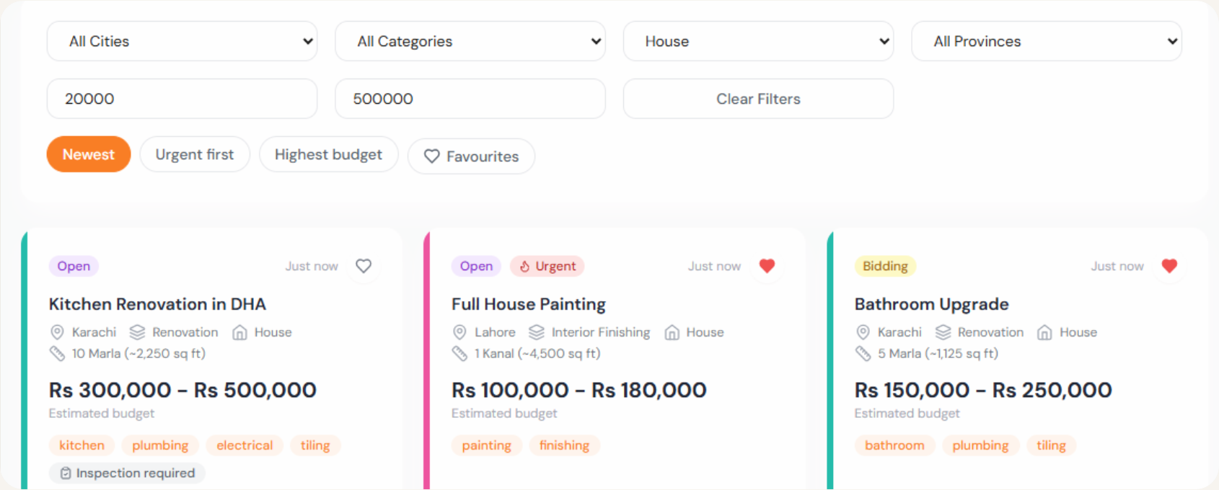
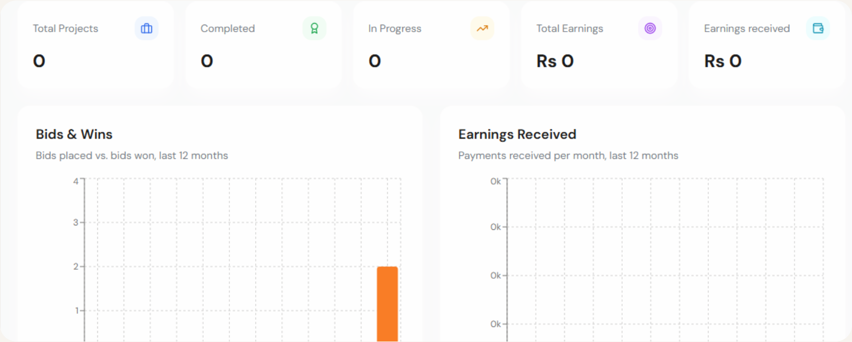
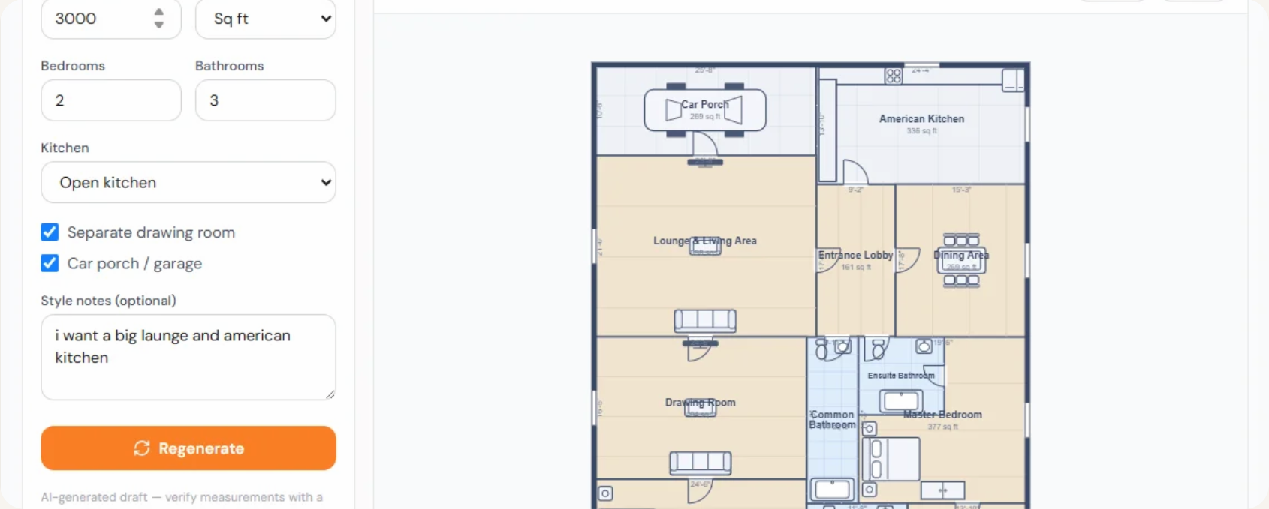
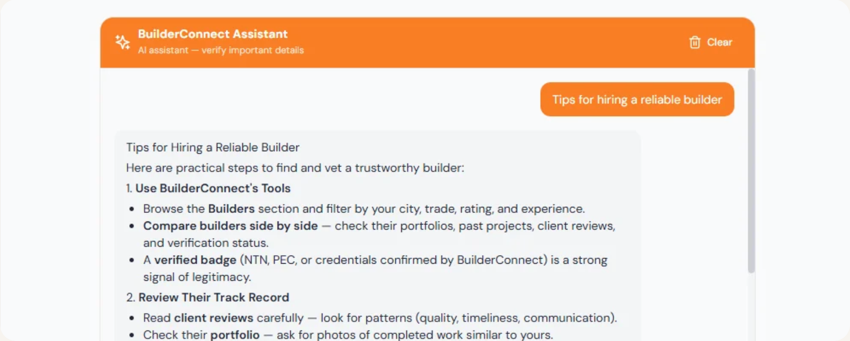
THE WORKING PRODUCT
Project as Product
Project Marketplace
Browse, filter & bid on posted projects.
Project Dashboard
Milestones, payments & progress.
Floor Plan Studio
AI-generated, editable floor plans.
AI Assistant
Advice on budgeting & construction.
Notes:
As a product, BuilderConnect is a working web application. These are the key surfaces clients and builders use every day.

Slide 13
HOW IT SUSTAINS ITSELF
Business Model
Two-sided marketplace
Builder subscriptions
More clients attract more builders — and vice versa.
Tiered plans (Free → Enterprise) unlock more active bids, portfolio slots & featured placement.
Clients Free to post & hire
⇄
Builders Pay to reach clients
Lead credits
Builders spend credits to unlock project leads — pay-as-you-grow on top of subscriptions.
Suppliers also sell materials through the marketplace, widening the network.
Notes:
It's a two-sided marketplace: free for clients to attract demand, monetized through builder subscriptions and lead credits on the supply side.

Slide 14
COSTING & PRICING
Product Costing
Development cost
Builder subscription tiers
Tooling & frameworks
Open-source
Free
Basic
Professional
POPULAR
Enterprise
Rs 0
Rs 2,999/30 days
Rs 7,999/30 days
Rs 14,999/30 days
Team effort (4 × 12 weeks)
In-kind
✓
5 lead credits / mo
✓
20 lead credits / mo
✓
50 lead credits / mo
✓
999 lead credits / mo
✓
3 active bids
✓
10 active bids
✓
25 active bids
✓
Unlimited active bids
Cloud hosting
~ Rs 6k / mo
✓
5 portfolio images
✓
15 portfolio images
✓
50 portfolio images
✓
Unlimited portfolio
✓
Advanced analytics
✓
Featured listing
✓
Featured listing
AI & API usage
Usage-based
✓
Priority support
✓
Priority support
✓
Advanced analytics
✓
Advanced analytics
Recurring run cost is low and scales with usage.
Notes:
Development leans on free and open-source tools, so build cost is mostly time plus modest cloud and AI usage. Revenue comes from the builder subscription tiers shown here, from Free up to Enterprise at Rs 14,999 per 30 days.

Slide 15
WHAT'S NEXT
Future Scope
→
Native mobile apps for Android & iOS.
→
Full online escrow payments at scale.
→
Smarter AI matching of builders to projects.
→
Supplier logistics & delivery tracking.
→
Multi-city expansion across Pakistan.
→
Full Urdu interface for wider reach.
Notes:
Next: native mobile apps, full online escrow payments, smarter AI matching, deeper supplier logistics, multi-city expansion and a full Urdu interface.

Slide 16
IN SUMMARY
A trusted, complete platform for Pakistan's builders
Solves a real, unaddressed problem in Pakistan's construction market.
A complete, working full-stack product across 8 roles.
AI-enhanced, secure and built to scale.
Thank you
Questions & discussion welcome
Notes:
To conclude: BuilderConnect solves a real problem in Pakistan's construction market with a complete, AI-enhanced, scalable platform. Thank you — we're happy to take questions.

